Slide 1
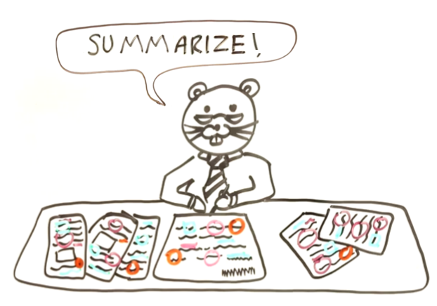
Summarizing Journal Articles
Visit our YouTube Channel
Student and Instructor Resources Website (inset hyperlink here)
Science Writing Resources for Learning
scwrl.ubc.ca

Slide 2
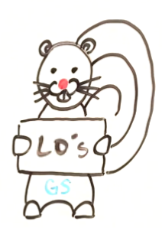
Learning Objectives
Consider which information is
important/vital when summarizing
scientific information
Verbally summarize your Science Outreach (SO) paper to someone who hasn’t read it
Verbally justify which information is important/vital in your SO paper (and needs to be summarized)
Provide constructive feedback on someone else’s SO paper summary
Work on improving your own SO paper summary based on peer feedback

Slide 3

Activity 1
(work together, 10 minutes)
Only focus on reporting the really important information when summarizing. As a general guide, when deciding whether to include specific information, ask yourself two questions:
Would leaving this information out…
` (1) Lead to a biased interpretation of the original article?
(2) Make it hard for readers to understand what the original article showed?
If you are preparing your summary for a general audience and the answer to these questions is ‘no’, then leave it out!

Slide 4
Activity 1
(work together, 10 minutes)
Try to: (1) decide whether to include the bolded specifics (Yes/No), before (2) re-writing the sentences in your own words to summarize the content succinctly.
S1: We used Michaelson XF-550 outdoor aviary cages to house the parrots that we used in our voice recognition study.
S2: We devised three treatment groups to allow us to compare recognition success rate under different circumstances: one included parrots (n=310) exposed to their owners’ voices every day, one included parrots (n=17) exposed to unfamiliar voices every day, and one included parrots (n=308) that were not exposed to any voices.
S3: We found that parrots exposed to their owners’ voices every day were significantly more successful at recognizing their owners’ in crowded rooms (Tukey’s HSD = 34.71, p = 0.02) than in either of the other groups, which did not differ significantly (Tukey’s HSD = 1.71, p = 0.42).

Slide 5
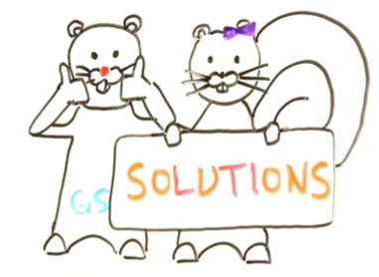
Activity 1 Solutions
Reasons as to why/why not the
specifics should be included in
sentences appear in red, while
example re-writes are italicized below these:
S1: We used Michaelson XF-550 outdoor aviary cages to house the parrots that we used in our voice recognition study.
This should NOT be included because it is jargon. Additionally, leaving it out does not not reduce the interpretability of the summary or bias what you are saying.
Example rewrite: Researchers kept parrots in outdoor aviary cages in the voice recognition study.

Slide 6
Activity 1 Solutions
S2: We devised three treatment groups to allow us to compare recognition success rate under different circumstances: one included parrots (n=310) exposed to their owners’ voices every day, one included parrots (n=17) exposed to unfamiliar voices every day, and one included parrots (n=308) that were not exposed to any voices.
This is debatable! Normally, it would be unnecessary to include this information but because the sample sizes were so different this might mean the study produced biased results (isn’t it odd that only 17 parrots were in one treatment group when 308 and 310 were in the others?). For this reason, whether the specifics are included as they are, or not, some mention to the discrepancy should be made.
Example rewrite: They compared recognition success rate of parrots that heard their owners’ voices every day with those that either heard strangers’ voices every day or lived in silence. However, a much smaller number of parrots were studied in the group that heard strangers’ voices than in the other two groups.

Slide 7
Activity 1 Solutions
S3: We found that parrots exposed to their owners’ voices every day were significantly more successful at recognizing their owners’ in crowded rooms (Tukey’s HSD = 34.71, p = 0.02) than parrots in either of the other groups, which did not differ significantly in success rate (Tukey’s HSD = 1.71, p = 0.42).
This should not be included; these numbers will not mean much to most people and do not need to be shown to tell an unbiased tale of what the journal article showed (or what the results were).
Example rewrite: Parrots that heard their owners’ voices every day were significantly better at recognizing their owners’ in crowded rooms than parrots kept in either of the other groups.

Slide 8
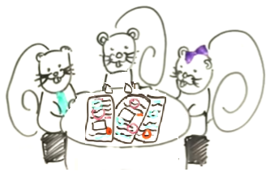
Activity 2
(work together, 5 minutes)
Find a partner or work in a group of three, but make sure you work with people outside your own project group.
Take out the summary of your Science Outreach article that you wrote as part of the pre-class activities. Also, take out the article itself (if you have it).
Without reading your summary word for word:
1: Tell your partner about the article/research
2: Tell them how you decided whether information was important enough to be included in your summary
3: Try to think of some information that you decided to leave out, even though it was somewhat important, and explain/justify why you left it out

Slide 9
Activity 3
(work together, 15 minutes)
Swap your summary with your partner
(and the related research article, if
you have it with you)
Your task is to provide each other
with constructive feedback (write
this on a piece of paper)
Comment on the content and style
of your partner’s summary
1: In terms of content, refer to the six questions on your handout and ask whether your partner has addressed each of these (without including boring, redundant, or over-specific detail)
2: In terms of style, remember all the writing skills you have learned in this course and look out for any associated errors

Slide 10
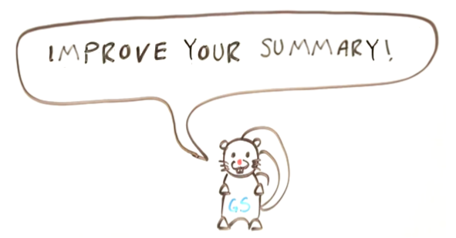
Activity 4
(work alone, 10 minutes)
Use the constructive feedback you received from your partner to improve the quality of your summary
If you run out of time, do not worry; there is a similar activity in the post-class assignment

