Slide 1
Succinct Writing, Dealing with Jargon
Visit our YouTube Channel
Student and Instructor Resources Website (inset hyperlink here)
Science Writing Resources for Learning
scwrl.ubc.ca

Slide 2
Activity 1
(work alone, 10 minutes)
Refer to your handout to see the explanations of the specific errors highlighted in red in this paragraph. If you have time, think about how you would re-write/improve these, but, most importantly, write down what you would say as feedback to your friend (assuming he/she had given you this paragraph to review).
Competition for food resources that are completely¹ imperative for the survival of any individual of a species ensures that there are powerful selective forces² exerted³ on these individuals. Because competition should typically (in more cases than not⁴) be significantly⁵ higher between conspecifics⁶ than between members of different species, those that are impressive⁷ foragers⁸ typically pass their genes on to future generations in time to come^{9.} That individuals develop multi-faceted predator-induced context-dependent behavioural strategies¹⁰ in the short-term is also interesting. It shows that the burning¹¹ desire to survive can cause individuals to develop completely¹² unique strategies based on the environments in which they find themselves to be living in¹³.

Slide 3
Activity 1: Suggested solution
Note how the suggested solution for the general feedback you could give on this paragraph is both constructive and positive/encouraging:
“The paragraph contains a number of redundant words and phrases, which means you could make it more concise without losing the excellent and interesting content. Try to reduce the use of jargon, or explain it when you do use specialist language, so that anyone can understand the topic. You use overly complicated words in a few places, so perhaps think about replacing them with some that are easier to understand. If you can do those three things, I think the paragraph will be much more concise and easier to read.”

Slide 4
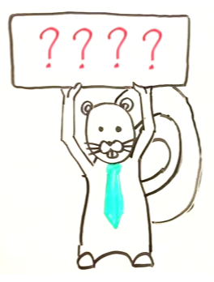
Activity 2
(work together, 10 minutes)
Take out the abstract that you re-wrote for one of the two journal articles posted on Connect (Question 10 of the pre-class assignment). Pass it to a partner, and have him/her provide some general feedback while you do the same for his/her abstract.
When reading your partner’s work before giving feedback, focus on answering the following four questions:
1: Are there any sentences that could be
more concise?
2: Are there any unnecessarily complicated
words or redundant qualifiers?
3: Are there any ambiguous words in the
sentences?
4: Is there any jargon that should be dealt
with?

Slide 5
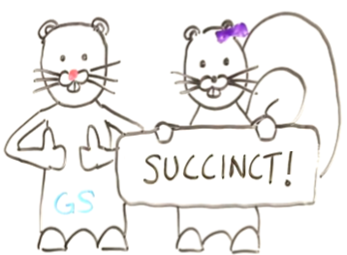
Activity 3
(work alone, and then together, 15 minutes)
Now, spend a few minutes to re-write your version of the abstract to improve it based on the feedback provided by your partner.
Once you have completed your re-write, pass it to the partner you worked with before, and:
                have him/her assess whether it has been improved
                tell him/her whether you found his/her feedback
                useful

Slide 6
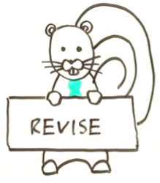
Activity 4
(as a class, 5 minutes)
Spend some time looking at the sample versions of the re-written abstracts to make sure you were on the right track in terms of highlighting issues with the writing, and phrasing your review in a constructive way. These sample revisions are on the handout your instructor will give you.
For both revisions:
Red text highlights parts of the original
that could be problematic and should be
changed
Superscript numbers refer to specific reasons that explain why the issue is problematic
Superscript letters refer to more general problems
A suggested revised version is provided

